Slide 1
Chapter 5
Recursion
Data Structure
Software College Northeastern University

Slide 2

Overview
Recursive Solutions
Mathemetical Induction and Recursion
Stack Activation Frames
Recursion and Iteration
Data Structure
Software College Northeastern University

Slide 3
Recursive Solutions
Sometimes, the best way to solve a problem is by solving a smaller version of the exact same problem first
Recursion is a technique that solves a problem by solving a smaller problem of the same type
A procedure that is defined in terms of itself
Data Structure
Software College Northeastern University

Slide 4
Recursion
When you turn that into a program, you end up with functions that call themselves:
Recursive Functions
Data Structure
Software College Northeastern University

Slide 5
Recursive Function
a recursion function is a function that either directly or indirectly makes a call to itself.
but we need to avoid making an infinite sequence of function calls (infinite recursion)
  int s (int n)
  {
  if (n ==1)
  return 1;
  else
  return s(n-1) + n;
  }
Data Structure
Software College Northeastern University

Slide 6
Finding a Recursive Solution
a recursive solution to a problem must be written carefully
the idea is for each successive recursive call to bring you one step closer to a situation in which the problem can easily be solved
this easily solved situation is called the base case
each recursive algorithm must have at least one base case, as well as a general (recursive) case
Data Structure
Software College Northeastern University

Slide 7
Overview
Recursive Solutions
Mathemetical Induction and Recursion
Stack Activation Frames
Recursion and Iteration
Data Structure
Software College Northeastern University

Slide 8

Mathemetical Induction
To prove
Let p(n) denote the statement involving the integer variable n. The Principle of Mathematical Induction states:
If p(1) is true and, for some integer K >=1 , p(k+1) is true whenever p(k) is true then p(n) is true for all n>=1 .
Data Structure
Software College Northeastern University

Slide 9
Mathemetical Induction
4 steps in using Induction:
  Base cases： --- p(1), p(2), …
  Induction hypothesis (IH);
  --- assume p(k) is true
  Statement to be proved in induction;
  --- it is true for p(k+1)
  Induction step.
  --- prove p(k+1) is true based on IH
Data Structure
Software College Northeastern University

Slide 10
A recursive definition
int s (int n)
{
if (n ==1)
return 1;
else
return s(n-1) + n;
}
A few of problems:
n ≤ 0 at the beginning;
return value might be too large to fit in an int.
Data Structure
Software College Northeastern University

Slide 11
General format for Many Recursive Functions
if (some easily-solved condition) // base case
solution statement
else // general case
recursive function call
Data Structure
Software College Northeastern University

Slide 12
Printing number in Any Base
String digitTable = "0123456789abcdef";
final int MAX_BASE = digitTable.length();
void printIntRec( int n, int base )
{
if( n >= base )
printIntRec( n / base, base );
System.out.print(digitTable.charAt(n % base));
}
Potential problems in this code:
  if base>16: --- out of bound;
  if base = 0: --- division by 0;
  if base = 1: --- infinite loop.
Data Structure
Software College Northeastern University

Slide 13
Overview
Recursive Solutions
Mathemetical Induction and Recursion
Stack Activation Frames
Recursion and Iteration
Data Structure
Software College Northeastern University

Slide 14
Common Programming Error
Recursion does not terminate properly: Stack Overflow !
Data Structure
Software College Northeastern University

Slide 15
When a function is called...
A transfer of control occurs from the calling block to the code of the function
--It is necessary that there be a return to the correct place in the calling block after the function code is executed;
This correct place is called the return address
When any function is called, the run-time stack is used
--On this stack is placed an activation record for the function call
Data Structure
Software College Northeastern University

Slide 16
Stack Activation Frames
The activation record contains the return address for this function call, and also the parameters, and local variables, and space for the function’s return value, if non-void .
The activation record for a particular function call is popped off the run-time stack when the final closing brace in the function code is reached, or when a return statement is reached in the function code.
At this time the function’s return value, if non-void, is brought back to the calling block return address for use there
Data Structure
Software College Northeastern University

Slide 17
A Stake of Activation Records
int s (int n)
{
if (n ==1)
return 1;
else
return s(n-1) + n;
}
public static void main(String[] args){
int sum;
sum = s(4); //instruction 100
System.out.print("sum= "+sum);
}
S(1)
S(2)
S(3)
S(4)
Main()
Data Structure
Software College Northeastern University

Slide 18
A recursive function
int func( int a, int b ){
int result;
if ( b == 0 ) // base case
result = 0;
else if ( b > 0 ) // first general case
result = a + func ( a , b - 1 ) ; // instruction 50
return result;
}
public static void main(String [] args){
int x;
x = func(5,2); //instruction 100
System.out.print(“x= ”+x);
}
Data Structure
Software College Northeastern University

Slide 19
Run-Time Stack Activation Records
FCTVAL ?
result ?
b 2
a 5
Return Address 100
x = func(5, 2);// original call at instruction 100
original call
at instruction 100
pushes on this record
for func(5,2)
Data Structure
Software College Northeastern University

Slide 20
Run-Time Stack Activation Records
x = func(5, 2);// original call at instruction 100
FCTVAL ?
result ?
b 1
a 5
Return Address 50
FCTVAL ?
result 5+func(5,1) = ?
b 2
a 5
Return Address 100
call in func(5,2) code
at instruction 50
pushes on this record
for func(5,1)
record for func(5,2)
Data Structure
Software College Northeastern University

Slide 21
Run-Time Stack Activation Records
x = func(5, 2);// original call at instruction 100
FCTVAL ?
result ?
b 0
a 5
Return Address 50
FCTVAL ?
result 5+func(5,0) = ?
b 1
a 5
Return Address 50
FCTVAL ?
result 5+func(5,1) = ?
b 2
a 5
Return Address 100
call in func(5,1) code
at instruction 50
pushes on this record
for func(5,0)
record for func(5,1)
record for func(5,2)
Data Structure
Software College Northeastern University

Slide 22
Run-Time Stack Activation Records
x = func(5, 2);// original call at instruction 100
FCTVAL 0
result 0
b 0
a 5
Return Address 50
FCTVAL ?
result 5+func(5,0) = ?
b 1
a 5
Return Address 50
FCTVAL ?
result 5+func(5,1) = ?
b 2
a 5
Return Address 100
record for func(5,0)
is popped first
with its FCTVAL
record for func(5,1)
record for func(5,2)
Data Structure
Software College Northeastern University

Slide 23
Run-Time Stack Activation Records
x = func(5, 2);// original call at instruction 100
FCTVAL 5
result 5+func(5,0) = 5+ 0
b 1
a 5
Return Address 50
FCTVAL ?
result 5+func(5,1) = ?
b 2
a 5
Return Address 100
record for func(5,1)
is popped next
with its FCTVAL
record for func(5,2)
Data Structure
Software College Northeastern University

Slide 24
Run-Time Stack Activation Records
x = func(5, 2);// original call at instruction 100
FCTVAL 10
result 5+func(5,1) = 5+5
b 2
a 5
Return Address 100
record for func(5,2)
is popped last
with its FCTVAL
Data Structure
Software College Northeastern University

Slide 25
Overview
Recursive Solutions
Mathemetical Induction and Recursion
Stack Activation Frames
Recursion and Iteration
Data Structure
Software College Northeastern University

Slide 26

Too much recursion Can Be Dangerous
Fibonacci numbers.
long fib (int n)
{
if (n <=1)
return n;
else
return fib(n-1) + fib(n-2);
}
F5
F4 F3
F3 F2 F2 F1
F2 F1 F1 F0 F1 F0
F1 F0
Data Structure
Software College Northeastern University

Slide 27
Too much recursion Can Be Dangerous
This definition will lead to exponential running time.
Reason:
-- too much redundant work
Not necessary to use recursive
Data Structure
Software College Northeastern University

Slide 28
Recursion vs. Iteration
You could have written the power-function iteratively, i.e. using a loop construction
Where’s the difference ?
Data Structure
Software College Northeastern University

Slide 29
Recursion vs. Iteration
Iteration can be used in place of recursion
  An iterative algorithm uses a looping structure
  A recursive algorithm uses a branching structure
Recursive solutions are often less efficient, in terms of both time and space, than iterative solutions
Recursion can simplify the solution of a problem, often resulting in shorter, more easily understood source code.
(Nearly) every recursively defined problem can be solved iteratively, iterative optimization can be implemented after recursive design.
Data Structure
Software College Northeastern University

Slide 30
Deciding whether to use a Recursive Function
When the depth of recursive calls is relatively “shallow”
The recursive version does about the same amount of work as the nonrecursive version
The recursive version is shorter and simpler than the nonrecursive solution
Data Structure
Software College Northeastern University

Slide 31
Recursion or Iteration?
CLARITY
EFFICIENCY
Data Structure
Software College Northeastern University

Slide 32
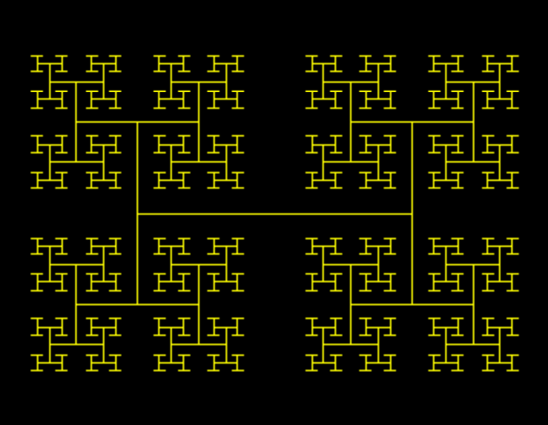
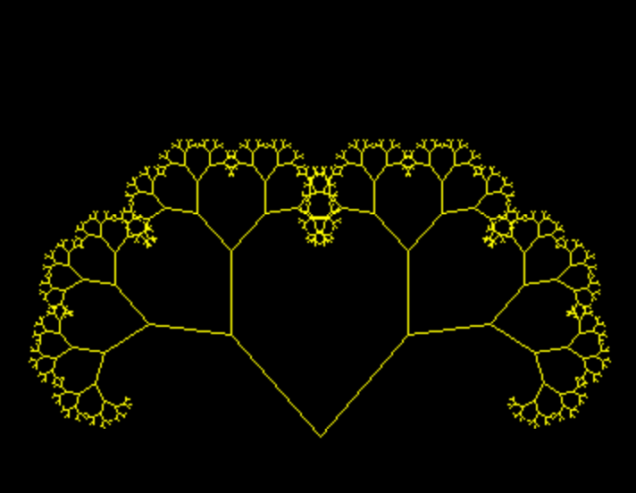
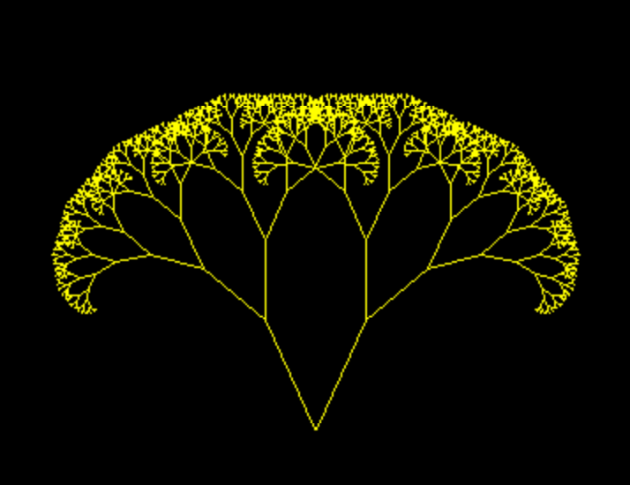
Examples: Fractal Tree
Data Structure
Software College Northeastern University

Slide 33
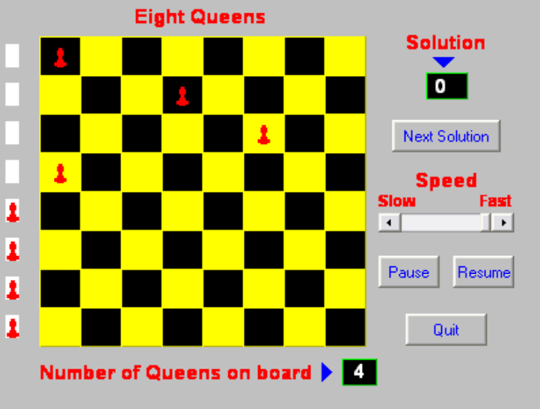
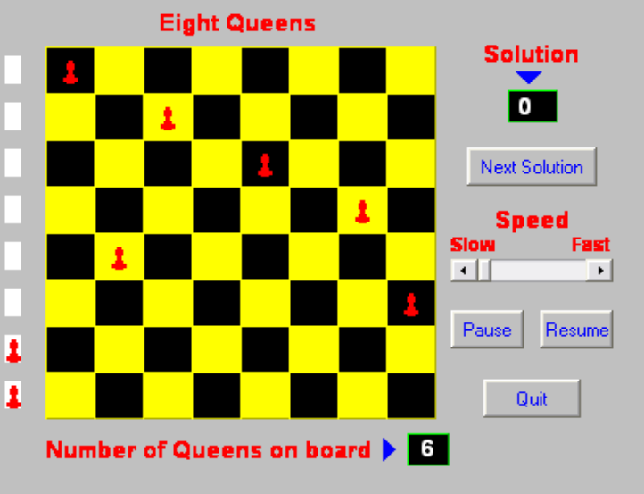
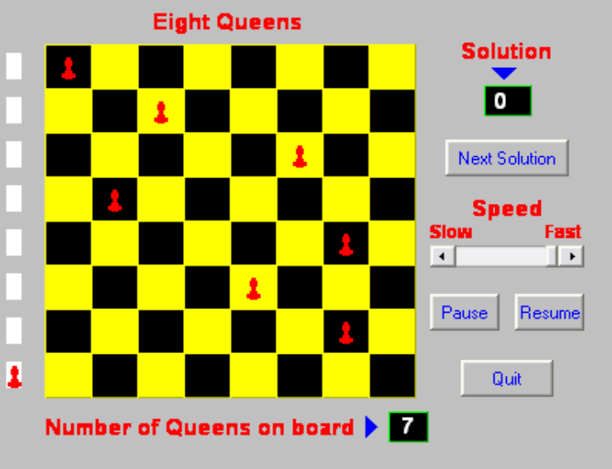
Examples: The 8 Queens Problem
Eight queens are to be placed on a chess board in such a way that no queen checks against any other queen
Data Structure
Software College Northeastern University

Slide 34
Backtracking
If we want to find (a) specific path in a search tree, we may use backtracking, i.e.
  going deep down into the tree until we either find a solution or understand that there cannot be a solution with this path and (in the latter case)
  go back (track back) in order to try another path.
Data Structure
Software College Northeastern University

Slide 35
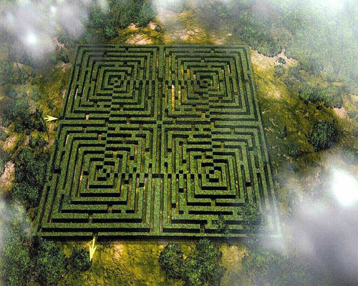
Traversing a Maze
Data Structure
Software College Northeastern University

Slide 36
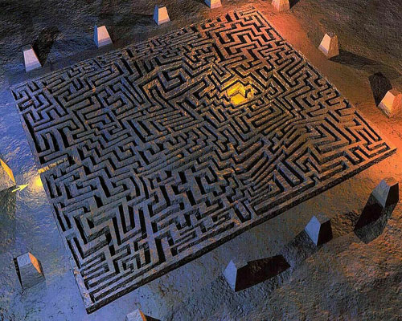
Traversing a Maze
Data Structure
Software College Northeastern University

Slide 37
Traversing a Maze
Entrance
Exit
Data Structure
Software College Northeastern University

Slide 38
树
Data Structure
Software College Northeastern University

Slide 39
Backtracking (cont.)
A
B
C
D
E
F
G
H
I
J
K
Solution Search Space is a tree
Each inner node is a set of alternatives that may lead to a solution.
Each leaf is either a solution or no solution.
We search this solution search space using recursion and backtracking to find a solution.
Data Structure
Software College Northeastern University

Slide 40
Generating the candidates
Classic backtrack algorithm:
At decision point, do something new
(extend something that hasn’t been added to this sequence at this place before.)
Fail: Backtrack: Undo most recent decision (retract).
Succeed: done
Data Structure
Software College Northeastern University

Slide 41
Backtracking (cont.)
Backtracking is a solution strategy that may be implemented using recursion. and a sequence of guesses that ultimately lead to a solution.
For any decision point, we should try all guesses that may ultimately lead to a solution. If a particular guess leads to an impasse (no solution), we retrace our steps in reverse order to replace our last guess with another option, try to complete the solution again.
Data Structure
Software College Northeastern University

Slide 42
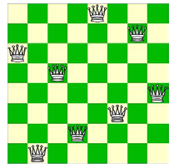
8-queens problem
Data Structure
Software College Northeastern University

Slide 43
The Eight Queens Problem
The Eight Queens Problem: Place eight queens on the chessboard so that no queen attack any other queen.
 |  | Q
Data Structure
Software College Northeastern University

Slide 44
Facts
8-queens has more than 281,474,976,711,000 candidates
Prune: reject nonviable candidates early, not just when sequence is complete.
Example: 8-queens with pruning looks at about 16,000 partial and complete candidates
12 solutions( 92 if we consider symmetry)
Data Structure
Software College Northeastern University

Slide 45
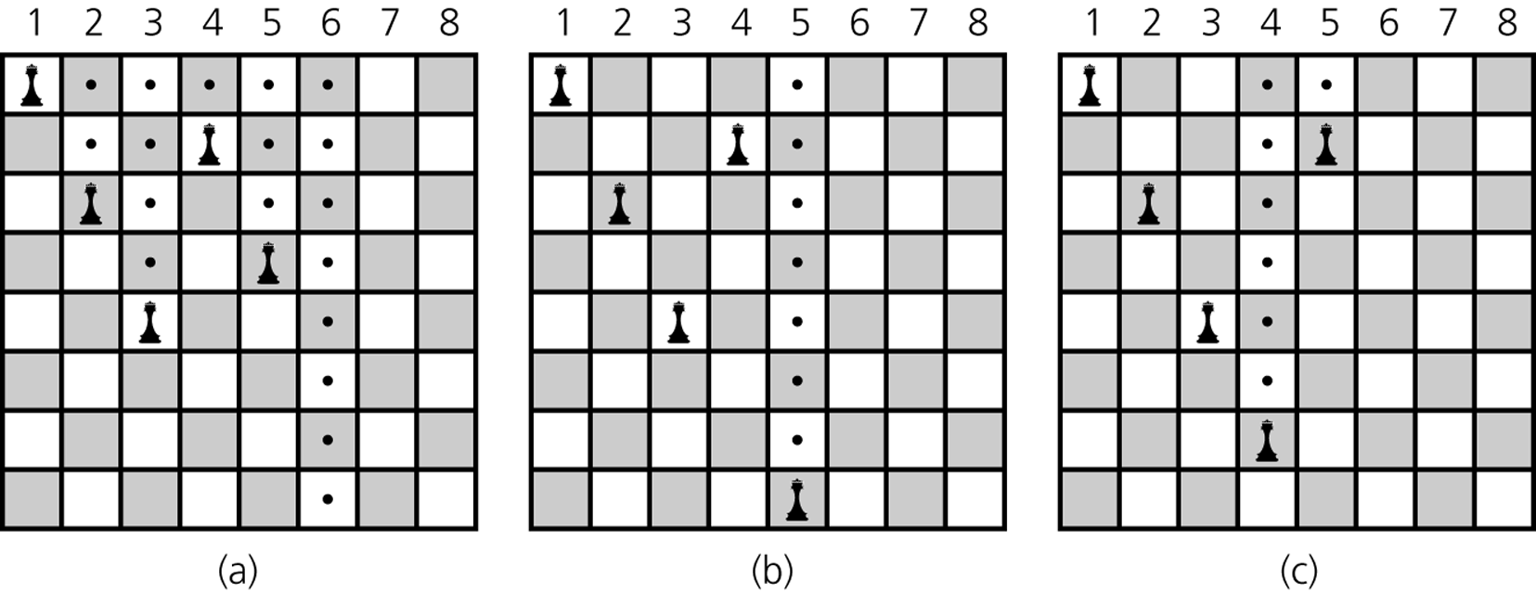
Eight Queens –Strategy
Five queens that cannot attack each other, but that can attack all of column 6;
backtracking to column 5 to try another square for the queen;
backtracking to column 4 to try another square for the queen and then considering column 5 again
Data Structure
Software College Northeastern University

Slide 46
Eight Queens – Class
public class EightQueens {
private static final int boardSize = 8; // squares per row or column
private int [] board = new int [boardSize];
// row-position per colomn queen, board is zero-indexed for columns
public EightQueens() {...} // Sets all squares to EMPTY.
public void clearBoard() {...} // Sets all squares to EMPTY.
public void displayBoard {...} // Displays the board.
private void setQueen(int row, int column) {...}
// Places a queen in a given row and column.
private void removeQueen(int row, int column) {...}
// Removes a queen from a given row and column.
private boolean isUnderAttack(int row, int column) {...}
/* Determines whether the square on the board at a given row and column is under attack by any queen in any column. */
Data Structure
Software College Northeastern University

Slide 47
Eight Queens – Class
private void placeQueens(int currColumn) {...}
// Places queens in columns of the board beginning at column specified.
/* Precondition: Queens are placed correctly in columns 0 through currColumn-1*/
/* Postcondition: If a solution is found, each column of board contains one queen and the function returns true otherwise returns false (no solution exists for a queen anywhere in column currColumn). */
public void placeQueen() { placeQueen(0); }
} // end class
Data Structure
Software College Northeastern University

Slide 48
private void placeQueens(int currColumn) {
if (currColumn == boardSize) displayBoard(); // base case
else{
int row = 0; // number of square in column
while ( row < boardSize) ) {
if (isUnderAttack(row, currColumn)) // if square can be attacked
++row; // then consider next square in currColumn
else { // else place queen and consider next column
setQueen(row, currColumn);
placeQueens(currColumn+1);
//backtrack: remove queen placed earlier and try next square in column
removeQueen(row, currColumn);
++row;
}
} // end of while
}
} // end placeQueens
Data Structure
Software College Northeastern University

Slide 49
Representation of a maze——maze[m+2][p+2]
1 1 1 1 1 1 1 1 1 1 1 1 1 1 1 1 1
0 0 1 0 0 0 1 1 0 0 0 1 1 1 1 1 1
1 1 0 0 0 1 1 0 1 1 1 0 0 1 1 1 1
1 0 1 1 0 0 0 0 1 1 1 1 0 0 1 1 1
1 1 1 0 1 1 1 1 0 1 1 0 1 1 0 0 1
1 1 1 0 1 0 0 1 0 1 1 1 1 1 1 1 1
1 1 1 0 1 0 0 1 0 1 1 1 1 1 1 1 1
1 0 0 1 1 0 1 1 1 0 1 0 0 1 0 1 1
1 0 0 1 1 0 1 1 1 0 1 0 0 1 0 1 1
1 0 1 1 1 1 0 0 1 1 1 1 1 1 1 1 1
1 0 0 1 1 0 1 1 0 1 1 1 1 1 0 1 1
1 0 1 0 0 1 1 1 0 0 0 0 0 0 0 0 0
1 1 1 1 1 1 1 1 1 1 1 1 1 1 1 1 1
In
Out
Data Structure
Software College Northeastern University

Slide 50
Examples: Maze Problem
save the path information in a stack
back to the point poped from stack
Element of triple：
public class items{
int x, y, dir;
}
x
y
dir
point
direction
Data Structure
Software College Northeastern University

Slide 51
Direction to next point
direction
NW(西北)
[i - 1][j - 1]
N(北)
[i - 1][j ]
NE(东北)
[i - 1][j +1]
W(西)
[i ][j -1]
x
[i ][j ]
E(东)
[i ][j +1]
[i+1 ][j -1]
SW(西南)
[i+1 ][j ]
S(南)
[i+1 ][j+1 ]
SE(东南)
Data Structure
Software College Northeastern University

Slide 52
public class offsets {
int a, b;
}
public enum directions{
N, NE, E, SE, S, SW, W, NW }
offsets[] move = new offsets[8];
the next point of (i, j) is (g, h) :
g = i + move[ SW].a = i + 1;
h = j + move[ SW].b = j – 1;
dir | move[dir].a | move[dir].b
N | -1 | 0
NE | -1 | 1
E | 0 | 1
SE | 1 | 1
S | 1 | 0
SW | 1 | -1
W | 0 | -1
NW | -1 | -1
Data Structure
Software College Northeastern University

Slide 53
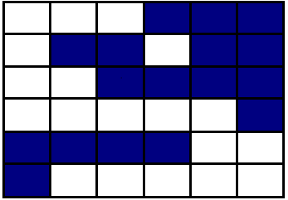
入口
出口
Data Structure
Software College Northeastern University

Slide 54
入口
3，（1，3），4
2，（1，2），3
1，（1，1），3
出口
Data Structure
Software College Northeastern University

Slide 55
Algorithm
/* 初始化工作栈，迷宫入口坐标和”E”方向首先进栈。
初始化mark为0，mark[i][j]==0，表示该位置未走
过。每当一个位置走过，mark[i][j]=1。防止走2次。*/
while ( 栈非空 ) {
( i, j, dir) = 从栈顶退出的坐标和方向;
while( 还有移动 ) {
(g, h) = 下一移动的坐标;
if ( g == m && h == p ) 迷宫搜索成功; //出口
if (!Maze[g][h] && !mark[g][h]) { //合法的移动
mark[g][h] = 1;
dir = 下一次将要移动的方向;
(i , j , dir ) 进栈;
i = g; j = h; dir = N;
}
}
}
Data Structure
Software College Northeastern University

Slide 56
void path ( int m, int p) {
mark[1][1] = 1; //(1, 1)是入口
Stack<items> st = new Stack( m*p ); //设置工作栈
items tmp； tmp.x = 1; tmp.y = 1; tmp.dir = E;
st.push(tmp);
while (!st.isEmpty ( ) ) {
tmp = st.pop();
int i = tmp.x; int j = tmp.y; int d = tmp.dir;
while ( d < 8 ) {
int g = i + move[d].a; int h = j + move[d].b;
Data Structure
Software College Northeastern University

Slide 57
if ( g = = m && h = = p ) {
st.displayStack();
System.out.println(“(” + i+ “,” + j + “)”);
System.out.println(“(” + m+ “,” + p + “)”);
return;
}
if ( !Maze[g][h] && !mark[g][h] ) {
mark[g][h] = 1;
tmp.x = i; tmp.y = j; tmp.dir = d + 1;
st.push( tmp); //Put the next corridor tmp into Stack
i = g; j = h; d = 0; //Move to the next intersection.
}
else d ++;
}
}
System.out.println(“No path in Maze”);
}
Data Structure
Software College Northeastern University

